Slide 1

FOUNDATIONS OF DATA SCIENCE
----------Box Office Prediction
Group 2
Jiaxin WU
Xin CHEN
Yibo YU
Qingyun Feng
Vahabov NATIG

Slide 2
Introduction
The topic : Movies
The main purpose: Predict the box office
User object: Movie investors/Movie lovers
Implementation: Webpage

Slide 3
Introduction
The reasons of our choice
Easy to collect the datasets
The idea is more practical
Similar application about prediction is popular
It covers everyone interest sphere
It can be preliminary test for movie investors
Other topics
The traffic in London
The store locator
The urban crime

Slide 4
Outline
Data Collection & Cleansing
Data Analysis & Algorithm
Data Visualization & Application
Conclusion

Slide 5





Source: http://weknowyourdreams.com/images/money/money-09.jpg

Slide 6

Source: http://weknowyourdreams.com/images/money/money-09.jpg

Slide 7
Movie
M_Name | Director | Actor/Actress | Profit
D_Name | M_Name
Director
A_Name | M_Name
Actor/Actress

Slide 8
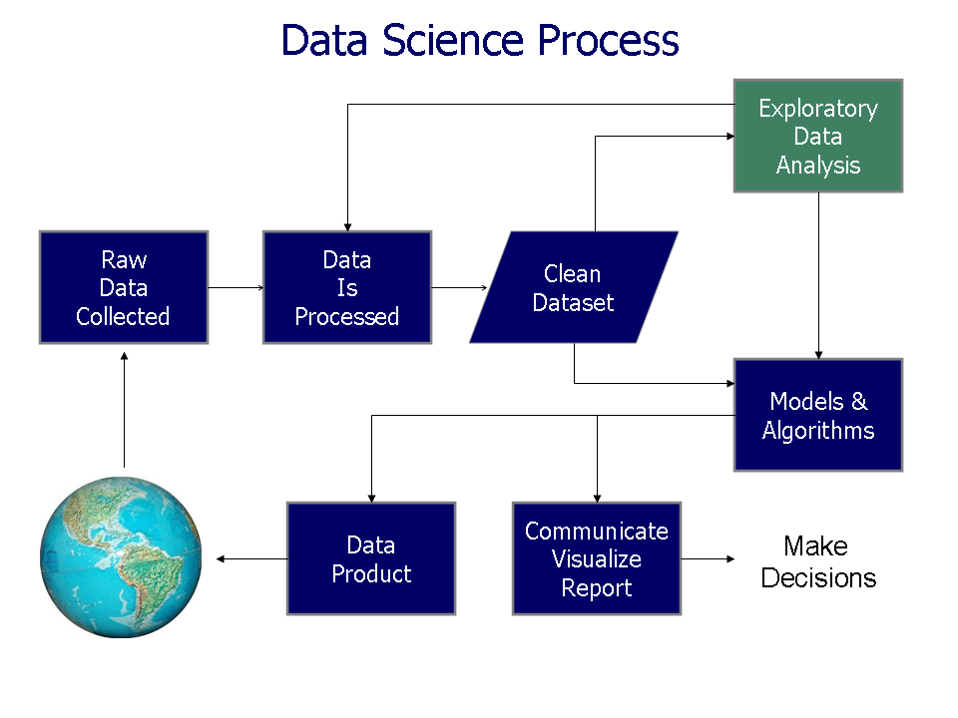
Source: https://en.wikipedia.org/wiki/Data_science#/media/File:Data_visualization_process_v1.png

Slide 9
Data Collection & Cleansing
http://www.imdb.com/list/ls006266261/
Year
Title | Year | Directors | IMDb_Rating | actor/actress1
> 1990
actor/actress2 | actor/actress3 | actor/actress4 | box_office | bugget
Movie

Slide 10
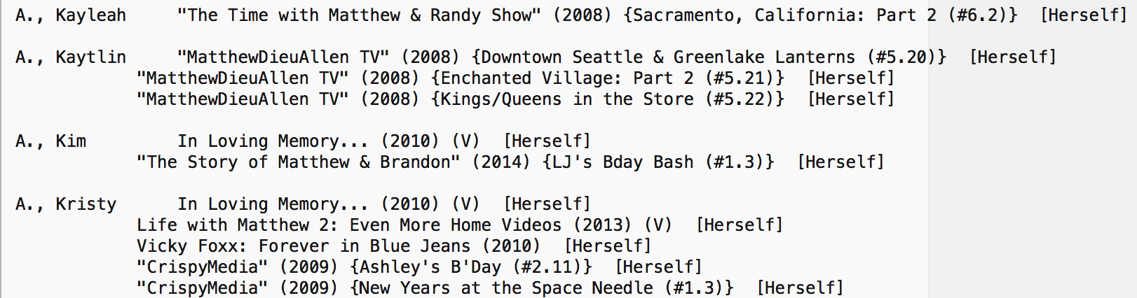
Data Collection & Cleansing
ftp://ftp.funet.fi/pub/mirrors/ftp.imdb.com/pub/

Slide 11
Data Cleansing
Director
Actor/Actress
D_Name | M_Name
A_Name | M_Name
Title | Directors | IMDb_Rating | actor/actress1 - 4
…
Movie

Slide 12
Data Cleansing
Director
Actor/Actress
D_Name | M_Name
A_Name | M_Name
108.5 MB -> 29 KB
1.64 GB -> 307 KB
Title | Directors | IMDb_Rating | actor/actress1
actor/actress2 | actor/actress3 | actor/actress4 | box_office | bugget
Movie
258 KB -> 102 KB

Slide 13
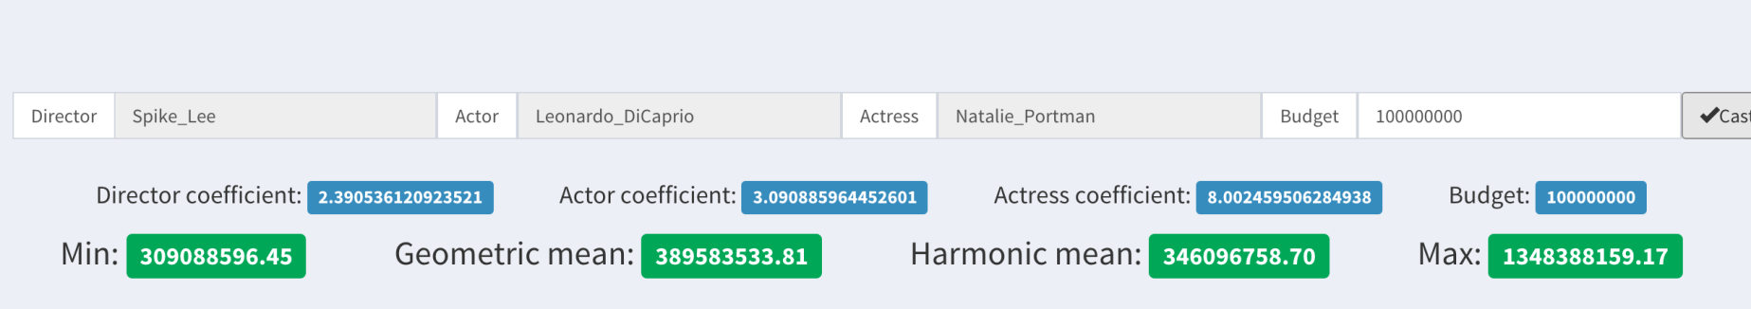
Data Analysis & Algorithm
Example:
Director: Spike Lee Actor: Leonardo DiCaprio Actress: Natalie Portman
Budget: $ 10000000
Box Office Evaluation:
Min Box Office: $ 309088596.45 Max Box Office: $ 1348388159.17
Average Box Office Evaluation:
Geometric Mean: $ 389583533.81 Harmonic mean: $ 346096758.70

Slide 14
Algorithm Implementation
Return Rate of a movie:
R=box office/budget
Average return rate of a director’s movies:
( i is the total amount of movies)
Average return rate of an actor’s movies:
Average return rate of an actress’s movies:

Slide 15
Algorithm Implementation
b = budget
is the minimum of: , ,
is the minimum value of the estimated box office:
is the maximum value of the estimated box office:

Slide 16
Algorithm Implementation
Mean Value:
Arithmetic Mean:
Geometric Mean :
Harmonic Mean :

Slide 17

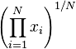
Algorithm Implementation
Geometric Mean:
In mathematics, the geometric mean is a type of mean or average, which indicates the central tendency or typical value of a set of numbers by using the product of their values (as opposed to the arithmetic mean which uses their sum). The geometric mean is defined as the nth root of the product of n numbers, i.e., for a set of numbers , he geometric mean is defined as .

Slide 18
Algorithm Implementation
Harmonic Mean:
In mathematics, the harmonic mean (sometimes called the subcontrary mean) is one of several kinds of average, and in particular one of the Pythagorean means. Typically, it is appropriate for situations when the average of rates is desired.

Slide 19
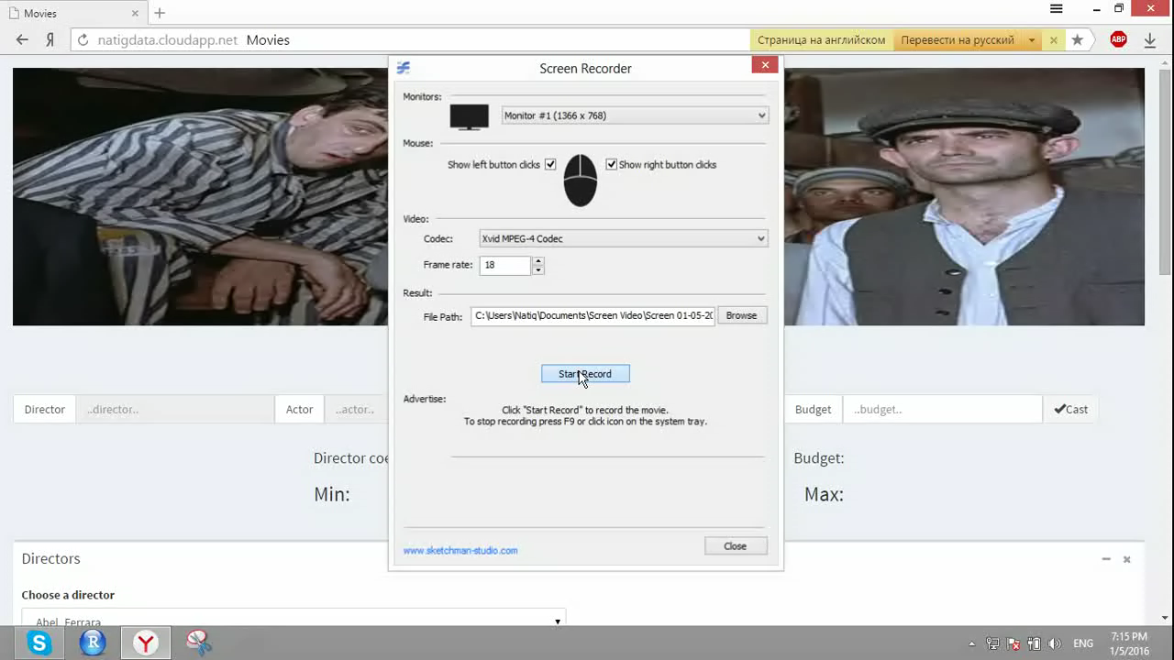
Demo

Slide 20
Technical implementation
PHP, Javascript, AJAX, Bootstrap -why PHP ?
MongoDB -why MongoDB?
Chart.js for data visualization -why Chart.js ?

Slide 21
Future Improvement
More data can be collected.
The algorithm can be more accurate.
More factors can be considered, like movie rating, genre.
Evaluation about famous directors, actors/actress can be done according to predicting results.

Slide 22
Conclusion
Tools: C++ ,MongoDB, php, HTML, CSS, JavaScript,Ajax,Chart.js
Process: data collection, data cleansing, data analysis/algorithm, data visualizing, web application
Impact:
It can estimate the future box office according to budget and the directors/actors/actresses you choose.
It can give suggestion to the movie investor.
it is an interesting application for movie lovers to estimate their own movie box office with favorites directors and actors/actresses.

